Slide 1

Designing an Automatic Car Parking Toll Gate using Arduino
Introduction
This presentation discusses the design and implementation of an automatic car parking toll gate using Arduino, exploring essential components and system architecture.
The automatic car parking toll gate system eliminates manual work,automating the process of vehicle detection,fee calculation and access control.The system can be scaled for a real-time parking management in public or private parking areas.

Slide 2
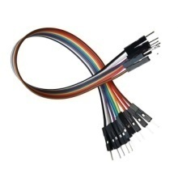
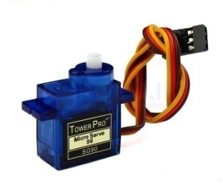
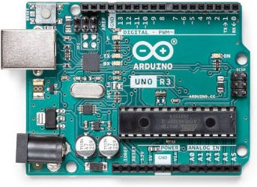
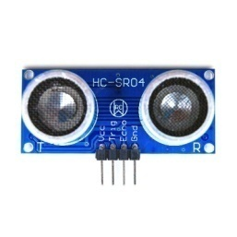
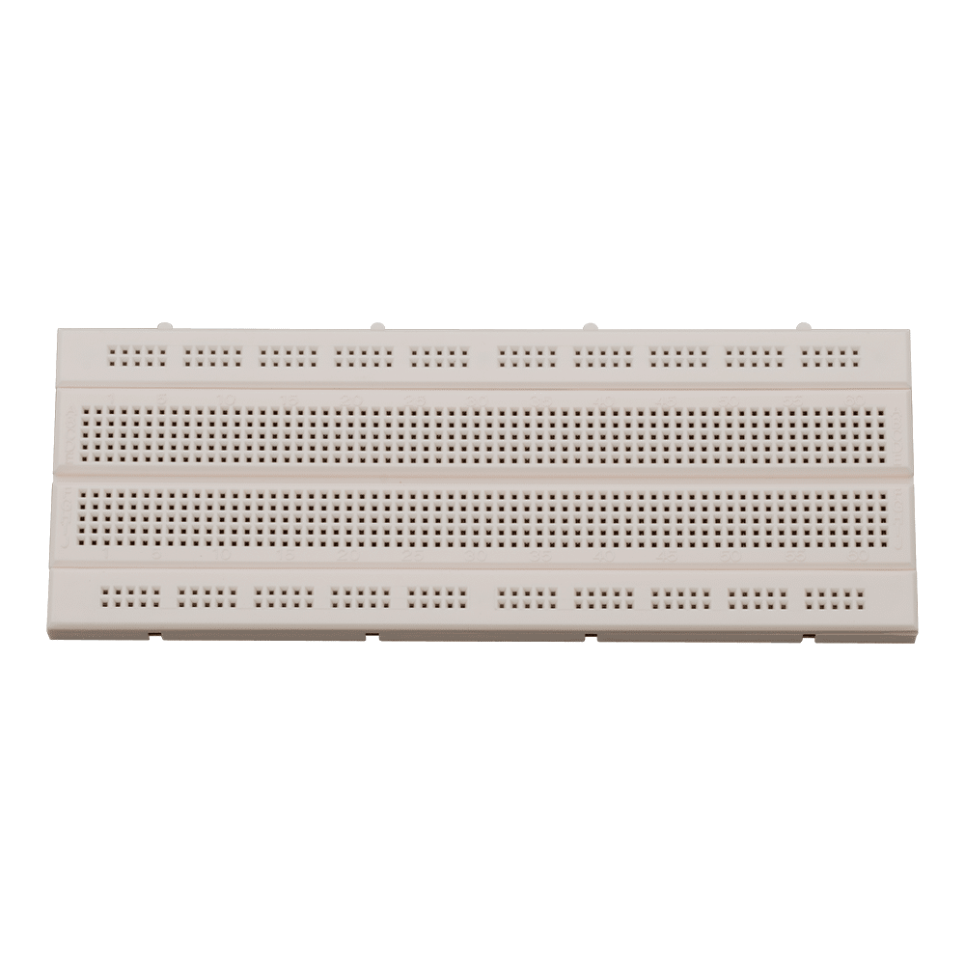
gate
System Components
Components required :
. Arduino UNO
. Jumper Wires
. Servo motor
. Ultrasonic Sensor
. Breadboard
. Cardboard rectangle
Objectives :
. To design an automated car parking system that detects a car's entry and exit
. To control the opening and closing of parking gate using servo motor
. To calculate the parking fee based on the time spent in the parking lot
. To provide a user-friendly display interface for fee calculation and payment

Slide 3
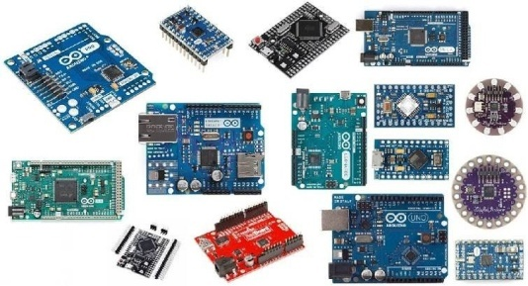
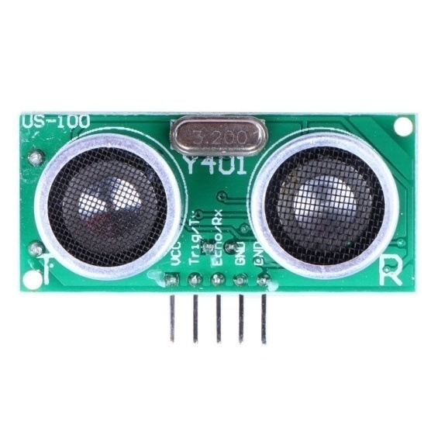
Sensors Required
Arduino Board Types
There are various Arduino boards available such as Arduino Uno, Mega, and Nano. Arduino Uno is highly recommended for beginners due to its simplicity and ease of use. Arduino Mega offers more I/O pins, which is beneficial for complex systems. Choose based on project requirements and scalability.
For this automated system, essential sensors include Ultrasonic distance sensors for vehicle detection, IR sensors for vehicle counting, and RFID modules for toll collection. These sensors provide accurate data for vehicle management and enhance system efficiency.

Slide 4
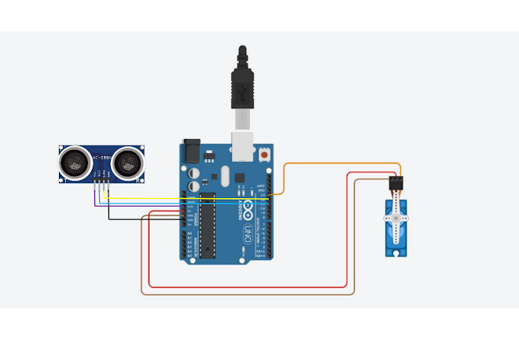
Programming Logic
Circuit Diagram Layout
The circuit diagram must clearly illustrate connections between the Arduino, sensors, and power supply. Include components such as relay ultrasonic sensors, and servo motor ensuring proper notation for inputs and outputs. This layout serves as a guide for hardware assembly and debugging
Programming logic dedicates how the automatic toll gate responds to ultrasonic sensor inputs.The software must manage sensor inputs, control outputs for barriers, and process toll transactions. Key steps include reading data from sensors, responding to vehicle detection, calculating fees, and updating the user interface.

Slide 5
Testing procedure
1. Hardware Setup:
Arduino Microcontroller: Choose an Arduino board (e.g., Uno, Nano).
Servo Motor: Connect a servo motor to control the gate's movement.
Wiring: Connect the sensors, servo motor, and Arduino according to the chosen sensor type and servo motor specifications.
2. Arduino Code:
  Ultrasonic Sensors: When the ultrasonic sensor detects a vehicle within a certain distance, trigger the servo motor to move to the 90 degree position (open).
Delay: Introduce a short delay to allow the vehicle to pass through.
Gate Return: After the delay, trigger the servo motor to return to its original position (0 degrees,closed).
3. Testing and Refinement:
Test the System: Thoroughly test the system to ensure it functions correctly.
Adjust Delays: Fine-tune the delays to match the desired gate opening and closing times.
Refine Code: Improve the code for efficiency and robustness.

Slide 6
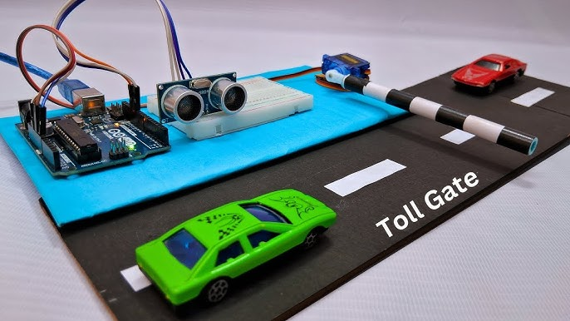
Conclusion
The project demonstrated the feasibility of using arduino for automatic parking toll gates,gate control and toll fee display.Future improvements could include better vehicle detection.This system has great potential for practical applications in parking facilities and could be further enhanced for scalability and efficiency.
By integrating various sensors and software, the system enhances user convenience and optimizes space usage.

Slide 7
THANK YOU
Presented by
BATCH 1
23A31A04P8
23A31A04P9
23A31A04Q0
23A31A04Q1
23A31A04Q2
23A31A04Q4

